Slide 1

Shape up your career with us

Slide 2
Data Analysis

Slide 3
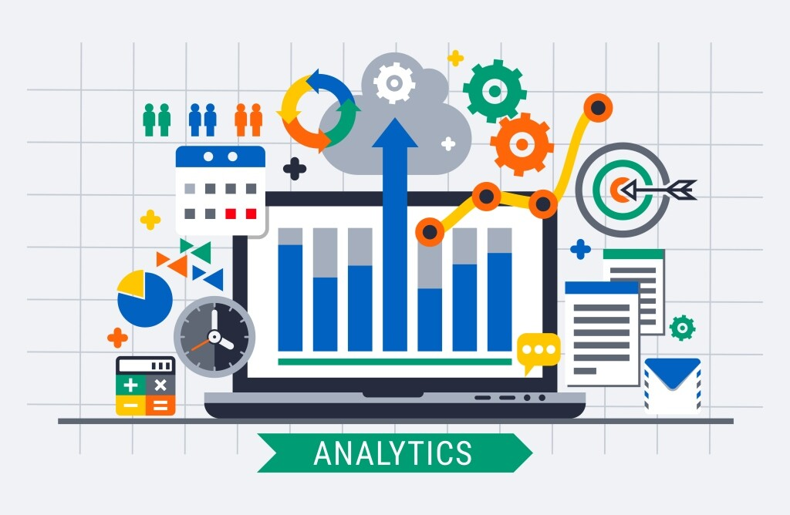

Slide 4
Introduction to Data analysis
information to transform metrics, facts, and figures into initiatives for improvement.
There are various methods for data analysis, largely based on two core areas: quantitative data analysis methods and data analysis methods in qualitative research.
What Is Data Analysis?
Data analysis is a process that relies on methods and techniques to taking raw data, mining for insights that are relevant to the business’s primary goals, and drilling down into this

Slide 5
About Data analysis:
Gaining a better understanding of different techniques for data analysis, and methods in quantitative research as well as qualitative insights, will give your information analyzing efforts a more clearly defined direction, so it’s worth taking the time to allow this particular knowledge to sink in. Additionally, you will be able to create a comprehensive analytical report that will skyrocket your analysis processes.
1. Collaborate your needs
2. Establish your questions
3. Harvest your data
5. Omit useless data
6. Conduct statistical analysis
7. Build a data management roadmap
8. Integrate technology

Slide 6
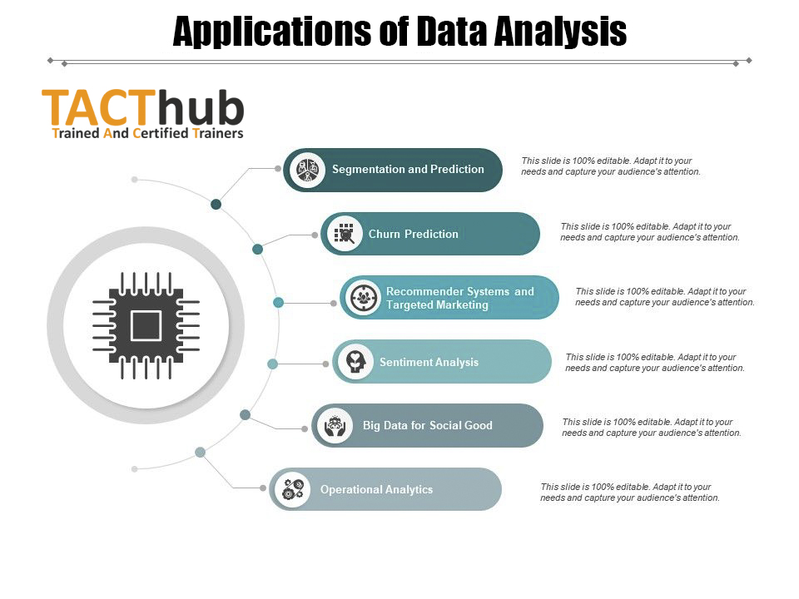
Application :

Slide 7
Types of Data Analysis :
Descriptive Analysis
Diagnostic Analysis
Predictive Analysis
Prescriptive Analysis

Slide 8
Descriptive Analysis
The first type of data analysis is descriptive analysis. It is at the foundation of all data insight. It is the simplest and most common use of data in business today. Descriptive analysis answers the “what happened” by summarizing past data, usually in the form of dashboards.
The biggest use of descriptive analysis in business is to track Key Performance Indicators (KPIs). KPIs describe how a business is performing based on chosen benchmarks.
Business applications of descriptive analysis include:
KPI dashboards
Monthly revenue reports
Sales leads overview

Slide 9
Diagnostic Analysis
After asking the main question of “what happened”, the next step is to dive deeper and ask why did it happen? This is where diagnostic analysis comes in.
Diagnostic analysis takes the insights found from descriptive analytics and drills down to find the causes of those outcomes. Organizations make use of this type of analytics as it creates more connections between data and identifies patterns of behavior.
A critical aspect of diagnostic analysis is creating detailed information. When new problems arise, it is possible you have already collected certain data pertaining to the issue. By already having the data at your disposal, it ends having to repeat work and makes all problems interconnected.
Business applications of diagnostic analysis include:
A freight company investigating the cause of slow shipments in a certain region
A SaaS company drilling down to determine which marketing activities increased trials

Slide 10
Predictive Analysis
Predictive analysis attempts to answer the question “what is likely to happen”. This type of analytics utilizes previous data to make predictions about future outcomes.
This type of analysis is another step up from the descriptive and diagnostic analyses. Predictive analysis uses the data we have summarized to make logical predictions of the outcomes of events. This analysis relies on statistical modeling, which requires added technology and manpower to forecast. It is also important to understand that forecasting is only an estimate; the accuracy of predictions relies on quality and detailed data.
While descriptive and diagnostic analysis are common practices in business, predictive analysis is where many organizations begin show signs of difficulty.
Business applications of predictive analysis include:
Risk Assessment
Sales Forecasting
Using customer segmentation to determine which leads have the best chance of converting
Predictive analytics in customer success teams

Slide 11
Prescriptive Analysis
The final type of data analysis is the most sought after, but few organizations are truly equipped to perform it. Prescriptive analysis is the frontier of data analysis, combining the insight from all previous analyses to determine the course of action to take in a current problem or decision.
Prescriptive analysis utilizes state of the art technology and data practices. It is a huge organizational commitment and companies must be sure that they are ready and willing to put forth the effort and resources.
Artificial Intelligence (AI) is a perfect example of prescriptive analytics. AI systems consume a large amount of data to continuously learn and use this information to make informed decisions. Well-designed AI systems are capable of communicating these decisions and even putting those decisions into action. Business processes can be performed and optimized daily without a human doing anything with artificial intelligence.
Currently, most of the big data-driven companies (Apple, Facebook, Netflix, etc.) are utilizing prescriptive analytics and AI to improve decision making. For other organizations, the jump to predictive and prescriptive analytics can be insurmountable.

Slide 12
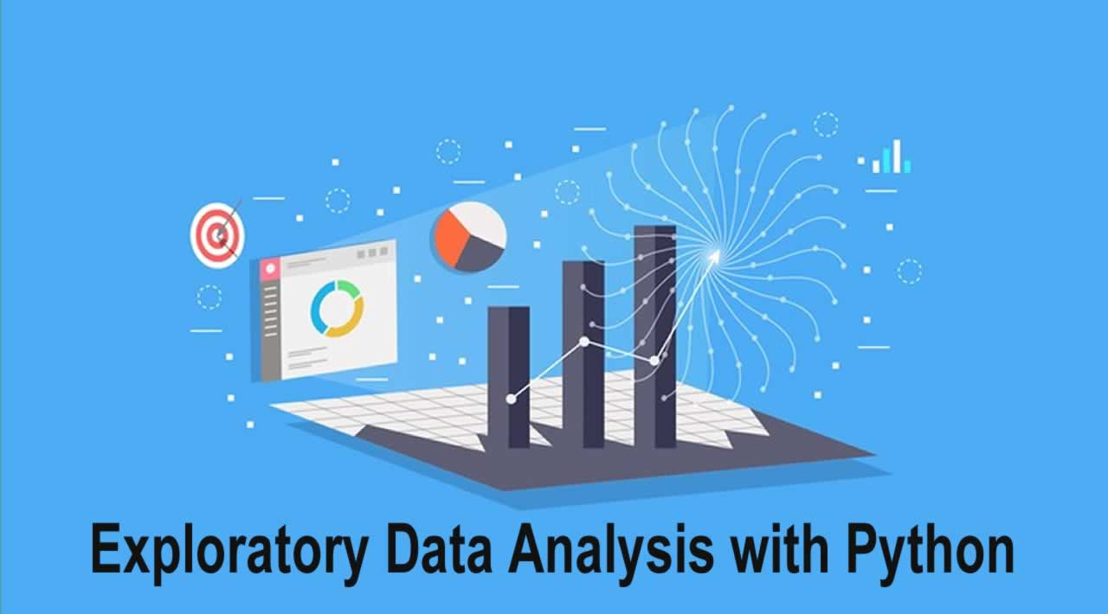

Slide 13
Important & feature:
1. NumPy
2. Theano
3. Pandas
4. StatsModel
5. SciPy
6 .Matplotlib
7. Seaborn
8. SciKit-Learn
.

Slide 14
QUESTION & ANSWER SESSION

